Slide 1
CELLULAR AUTOMATA
Anthony Tan
Stanley David
Karan Shah

Slide 2
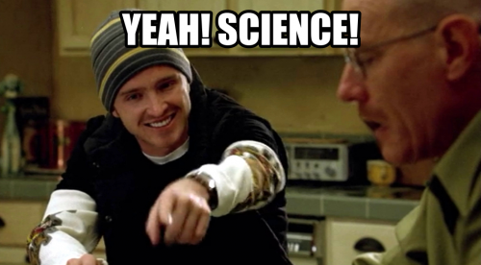
YOU CAN RUN THE APPLET AND DOWNLOAD THE CODE AT: HTTP://CA.KARANPRIME.SCIENCE (YEAH, .SCIENCE DOMAINS ARE A THING NOW)

Slide 3
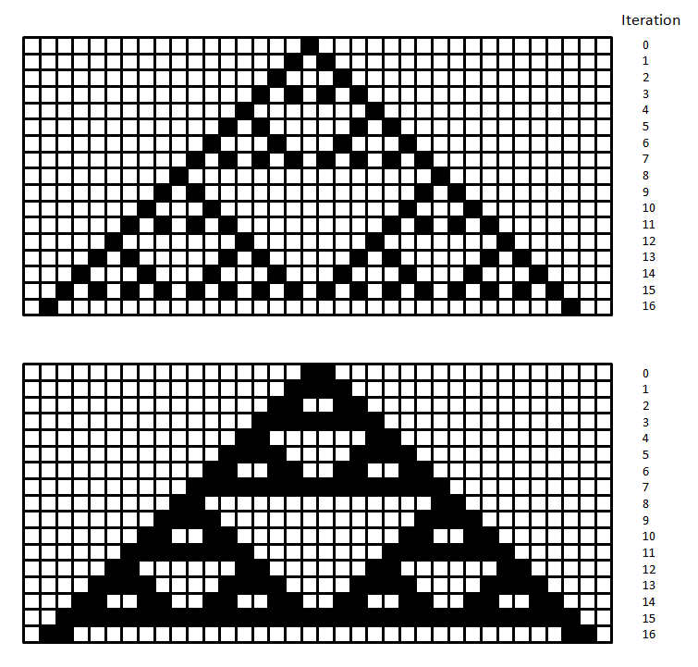
A cellular automaton is a series of grids of any size in which each square in the grid is either in an “on” state or an “off” state.
They can produce fractals too.

Slide 4
How do you generate a cellular automaton?
Just an initial set of squares set to “on” and a rule for updating. For example,
Conway’s game of life: 8 neighbors to each cell, Two Dimensional
If a cell has two dead neighbors, it stays the same as initial state.
If it has three or four dead neighbors, it becomes dead.
In all other situations it becomes alive.
Spiral Wave: 4 neighbors to each cell, Two Dimensional
The cell will activate if any of its neighbours are activated.
Cell will deactivate after activating.

Slide 5
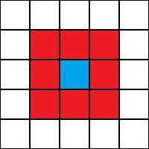
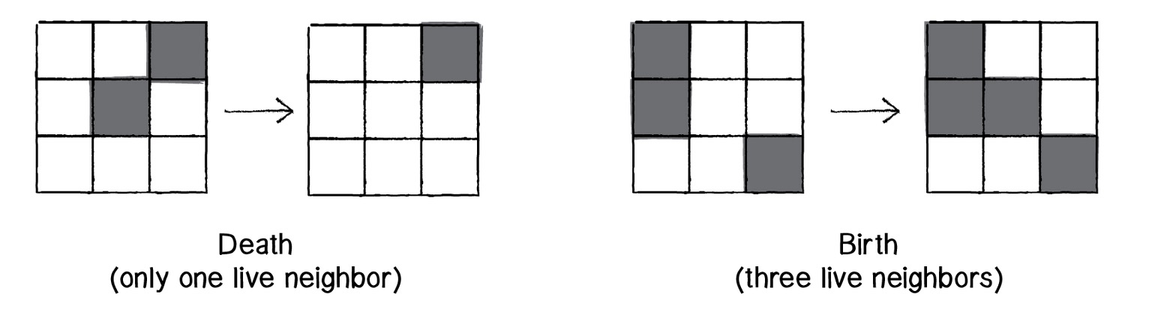
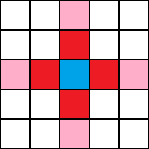
What is a neighborhood?
Moore neighborhood(Game of Life).
Von Neumann neighborhood(Spiral wave).

Slide 6
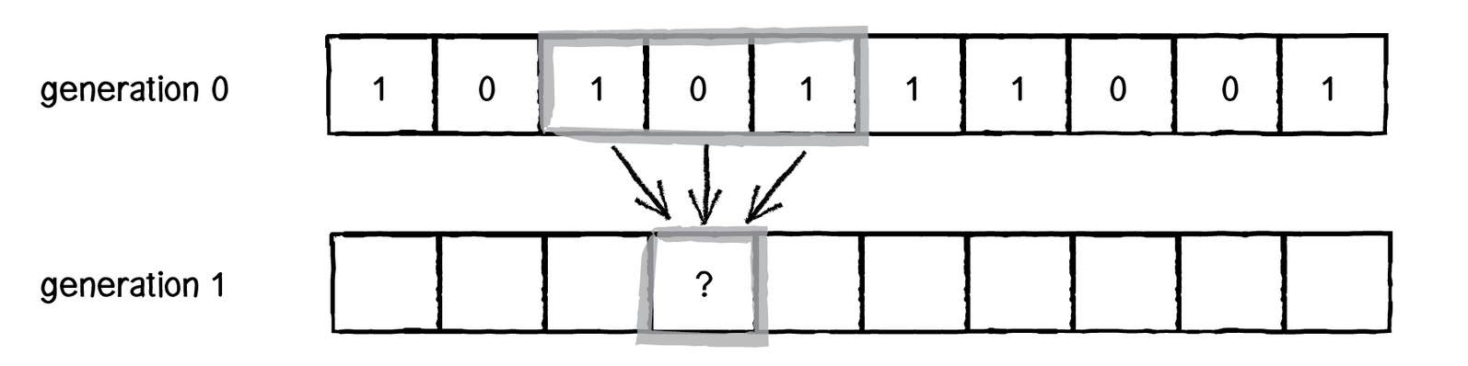
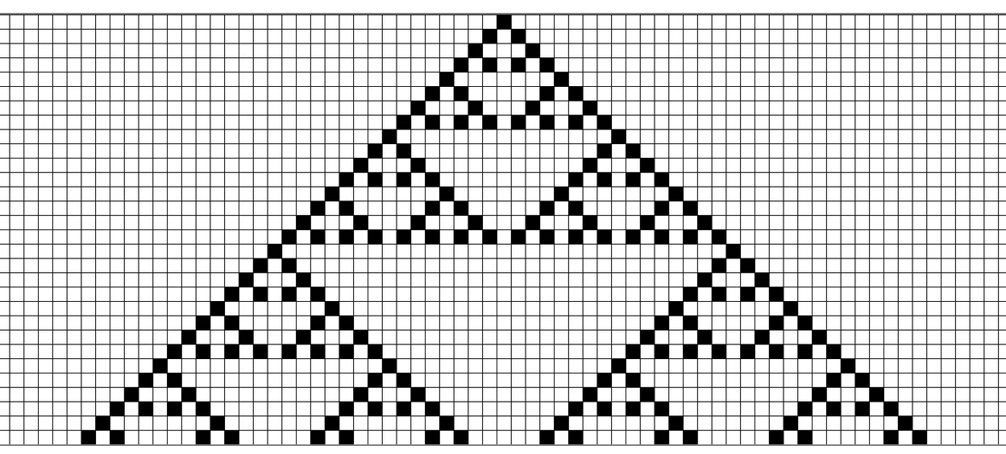
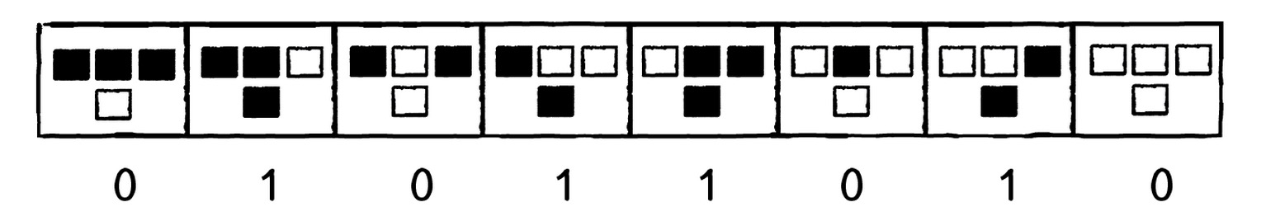
Elementary Cellular automata
One dimensional
Each cell has two neighbors
CELL state at time t = f(CELL neighborhood at time t - 1)

Slide 7
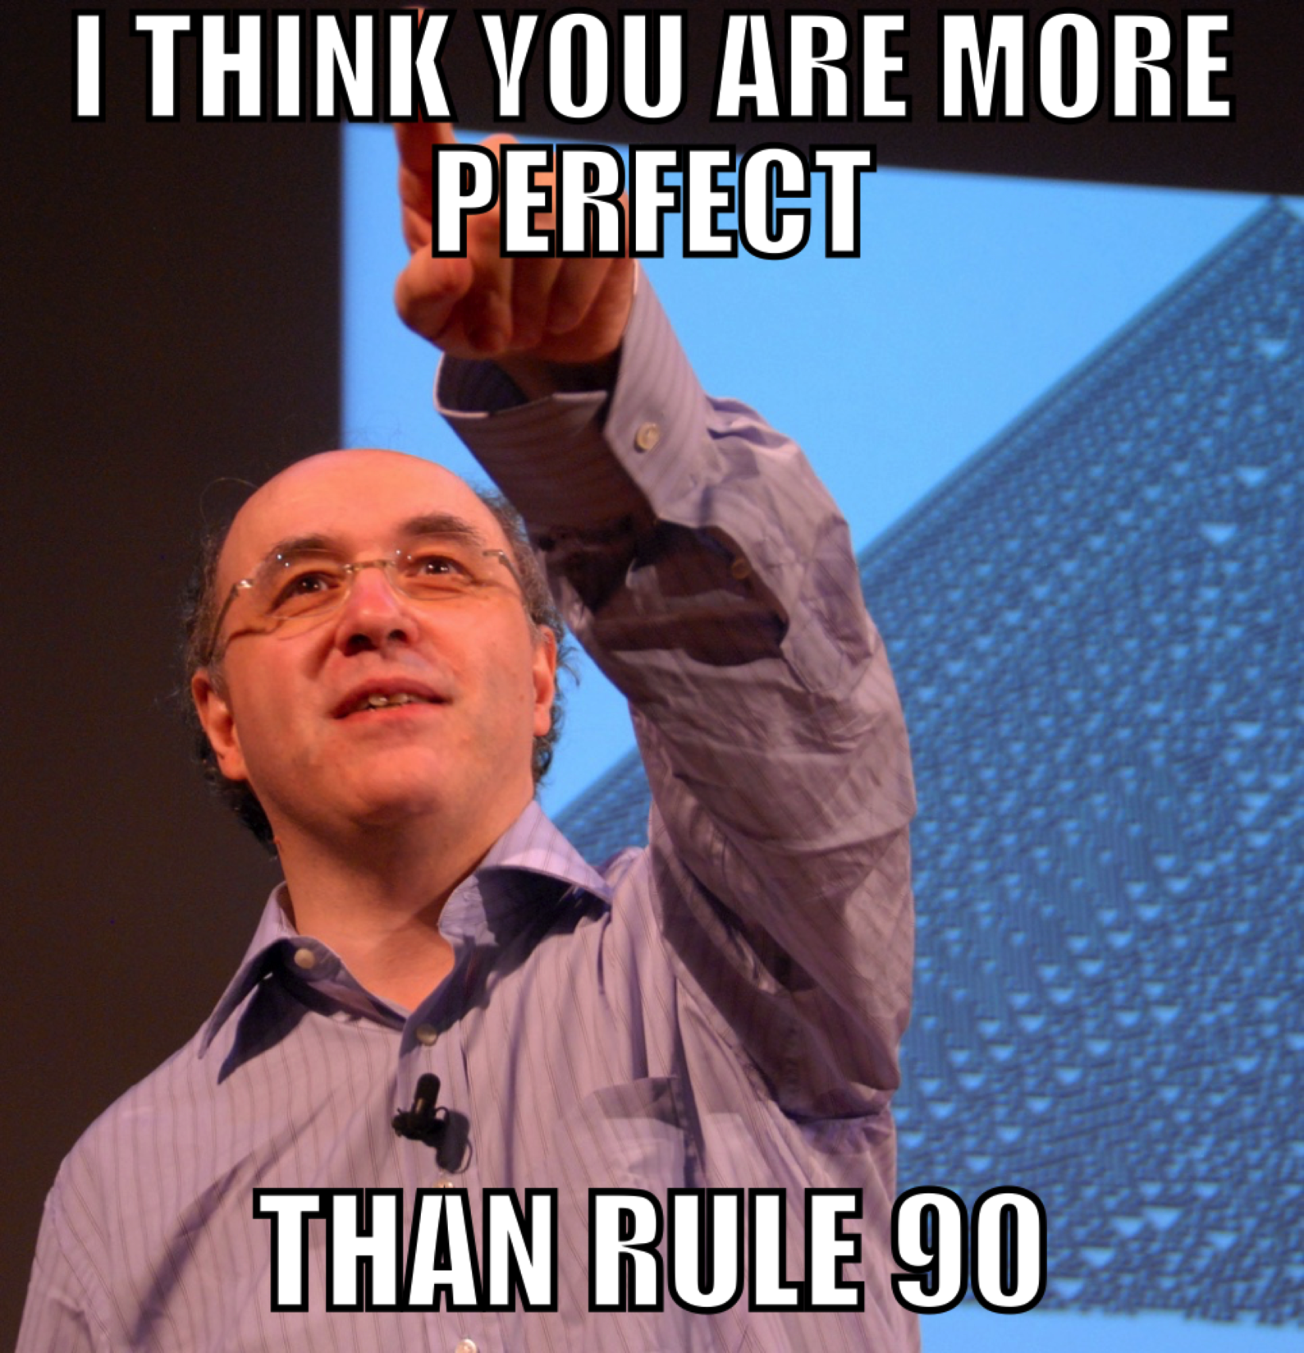
Chaos?
4 classes of elementary cellular automata(by Wolfram):
Class 1: Uniformity: Rule 222
Class 2: Repetition: Rule 190
Class 3: Random: Rule 30
Class 4: Complexity: Rule 110

Slide 8
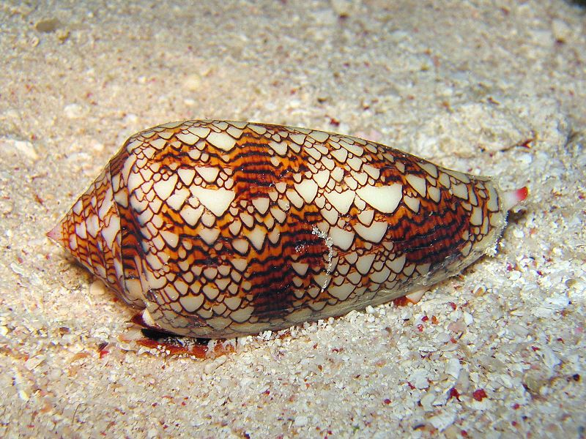
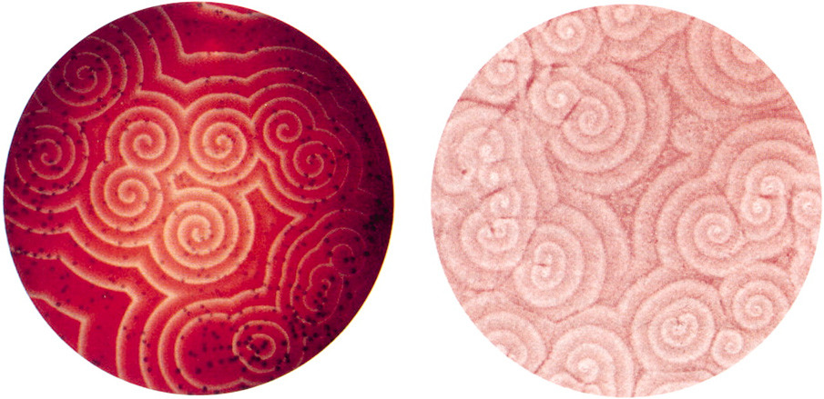
https://youtu.be/C2vgICfQawE?t=1m26s
Lots of applications and examples in nature:
Random number generator, music generator etc
All spiral wave simulations
Patterns in nature

